Slide 1
Variational Autoencoders

Slide 2
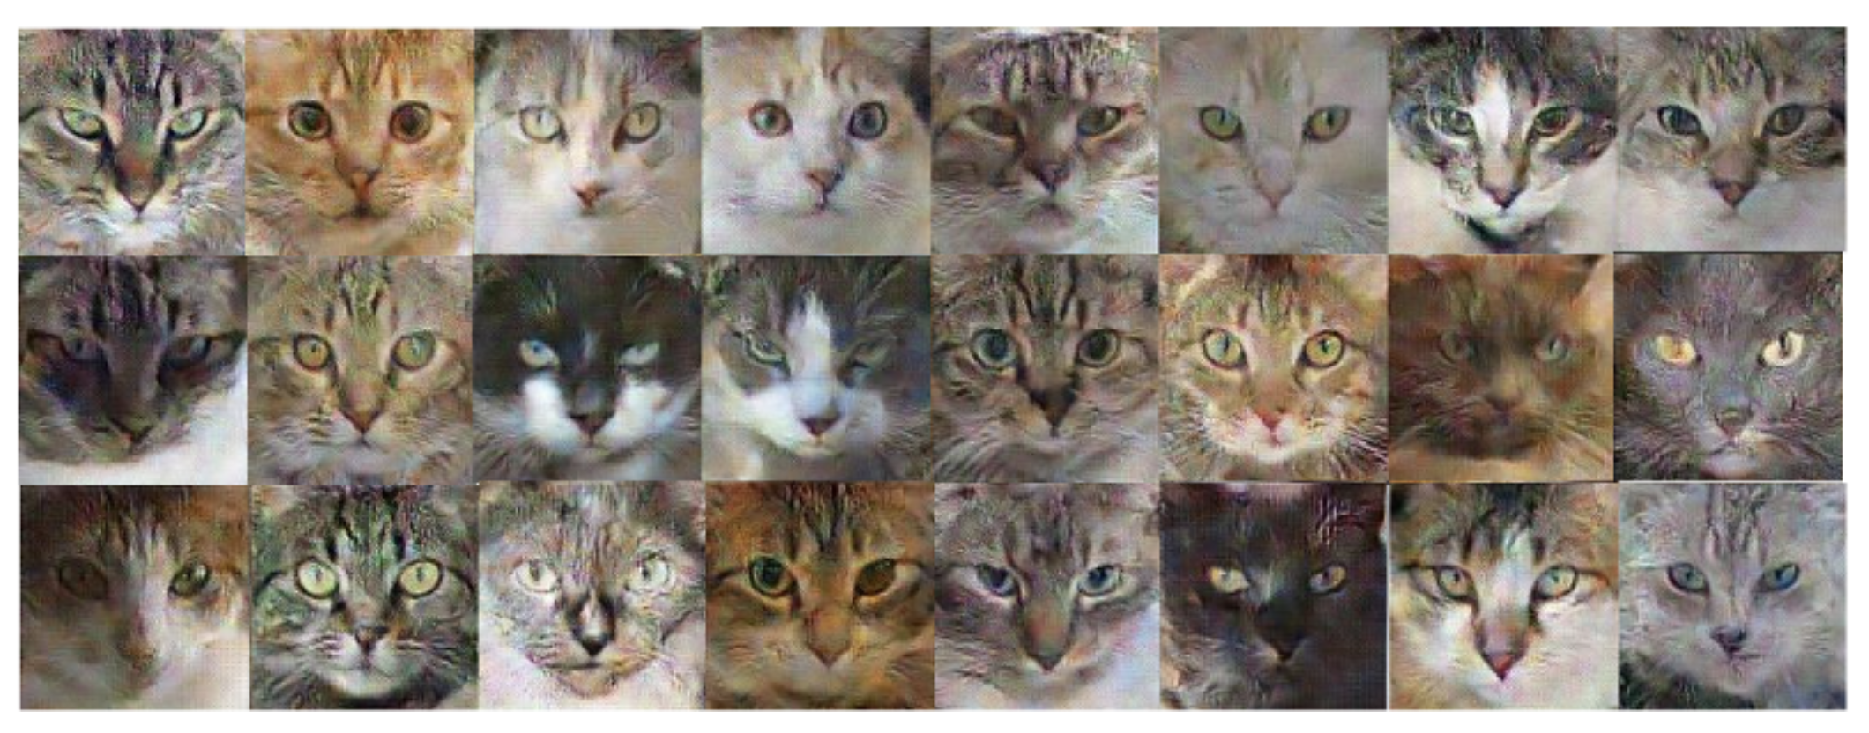
Generative Models
They take in data as input and learn to generate new data points from the same data distribution.
They learn the hidden representations using unsupervised learning techniques

Slide 3
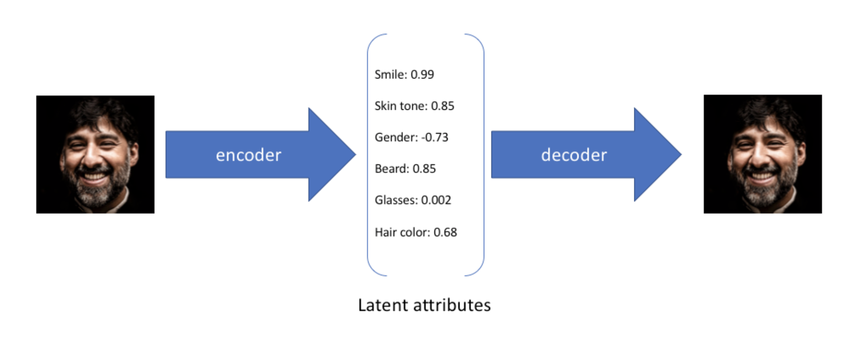
Variational Autoencoder
As the name suggests, it is an auto-encoder, which learns attributes from the data points and represents them in terms of latent variables.

Slide 4
Problems
How can we make use of the auto-encoder architecture to generate new data points ?
Assuming we can pass a vector from that learnt latent space to the decoder, how can we guarantee it’s not going to result in a garbage output.
VAEs address the above problems

Slide 5
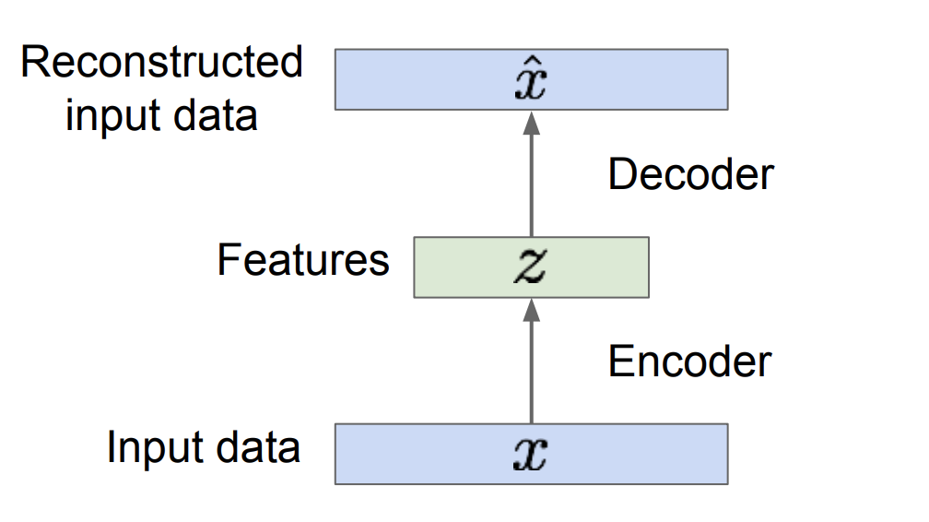
How do we use the Auto Encoder Architecture for generation ?
So, if we train the Auto encoder network and somehow learn the data distribution of the latent space, we can then sample from that latent space and pass it down to decoder and generate data points
But, there is a problem.

Slide 6
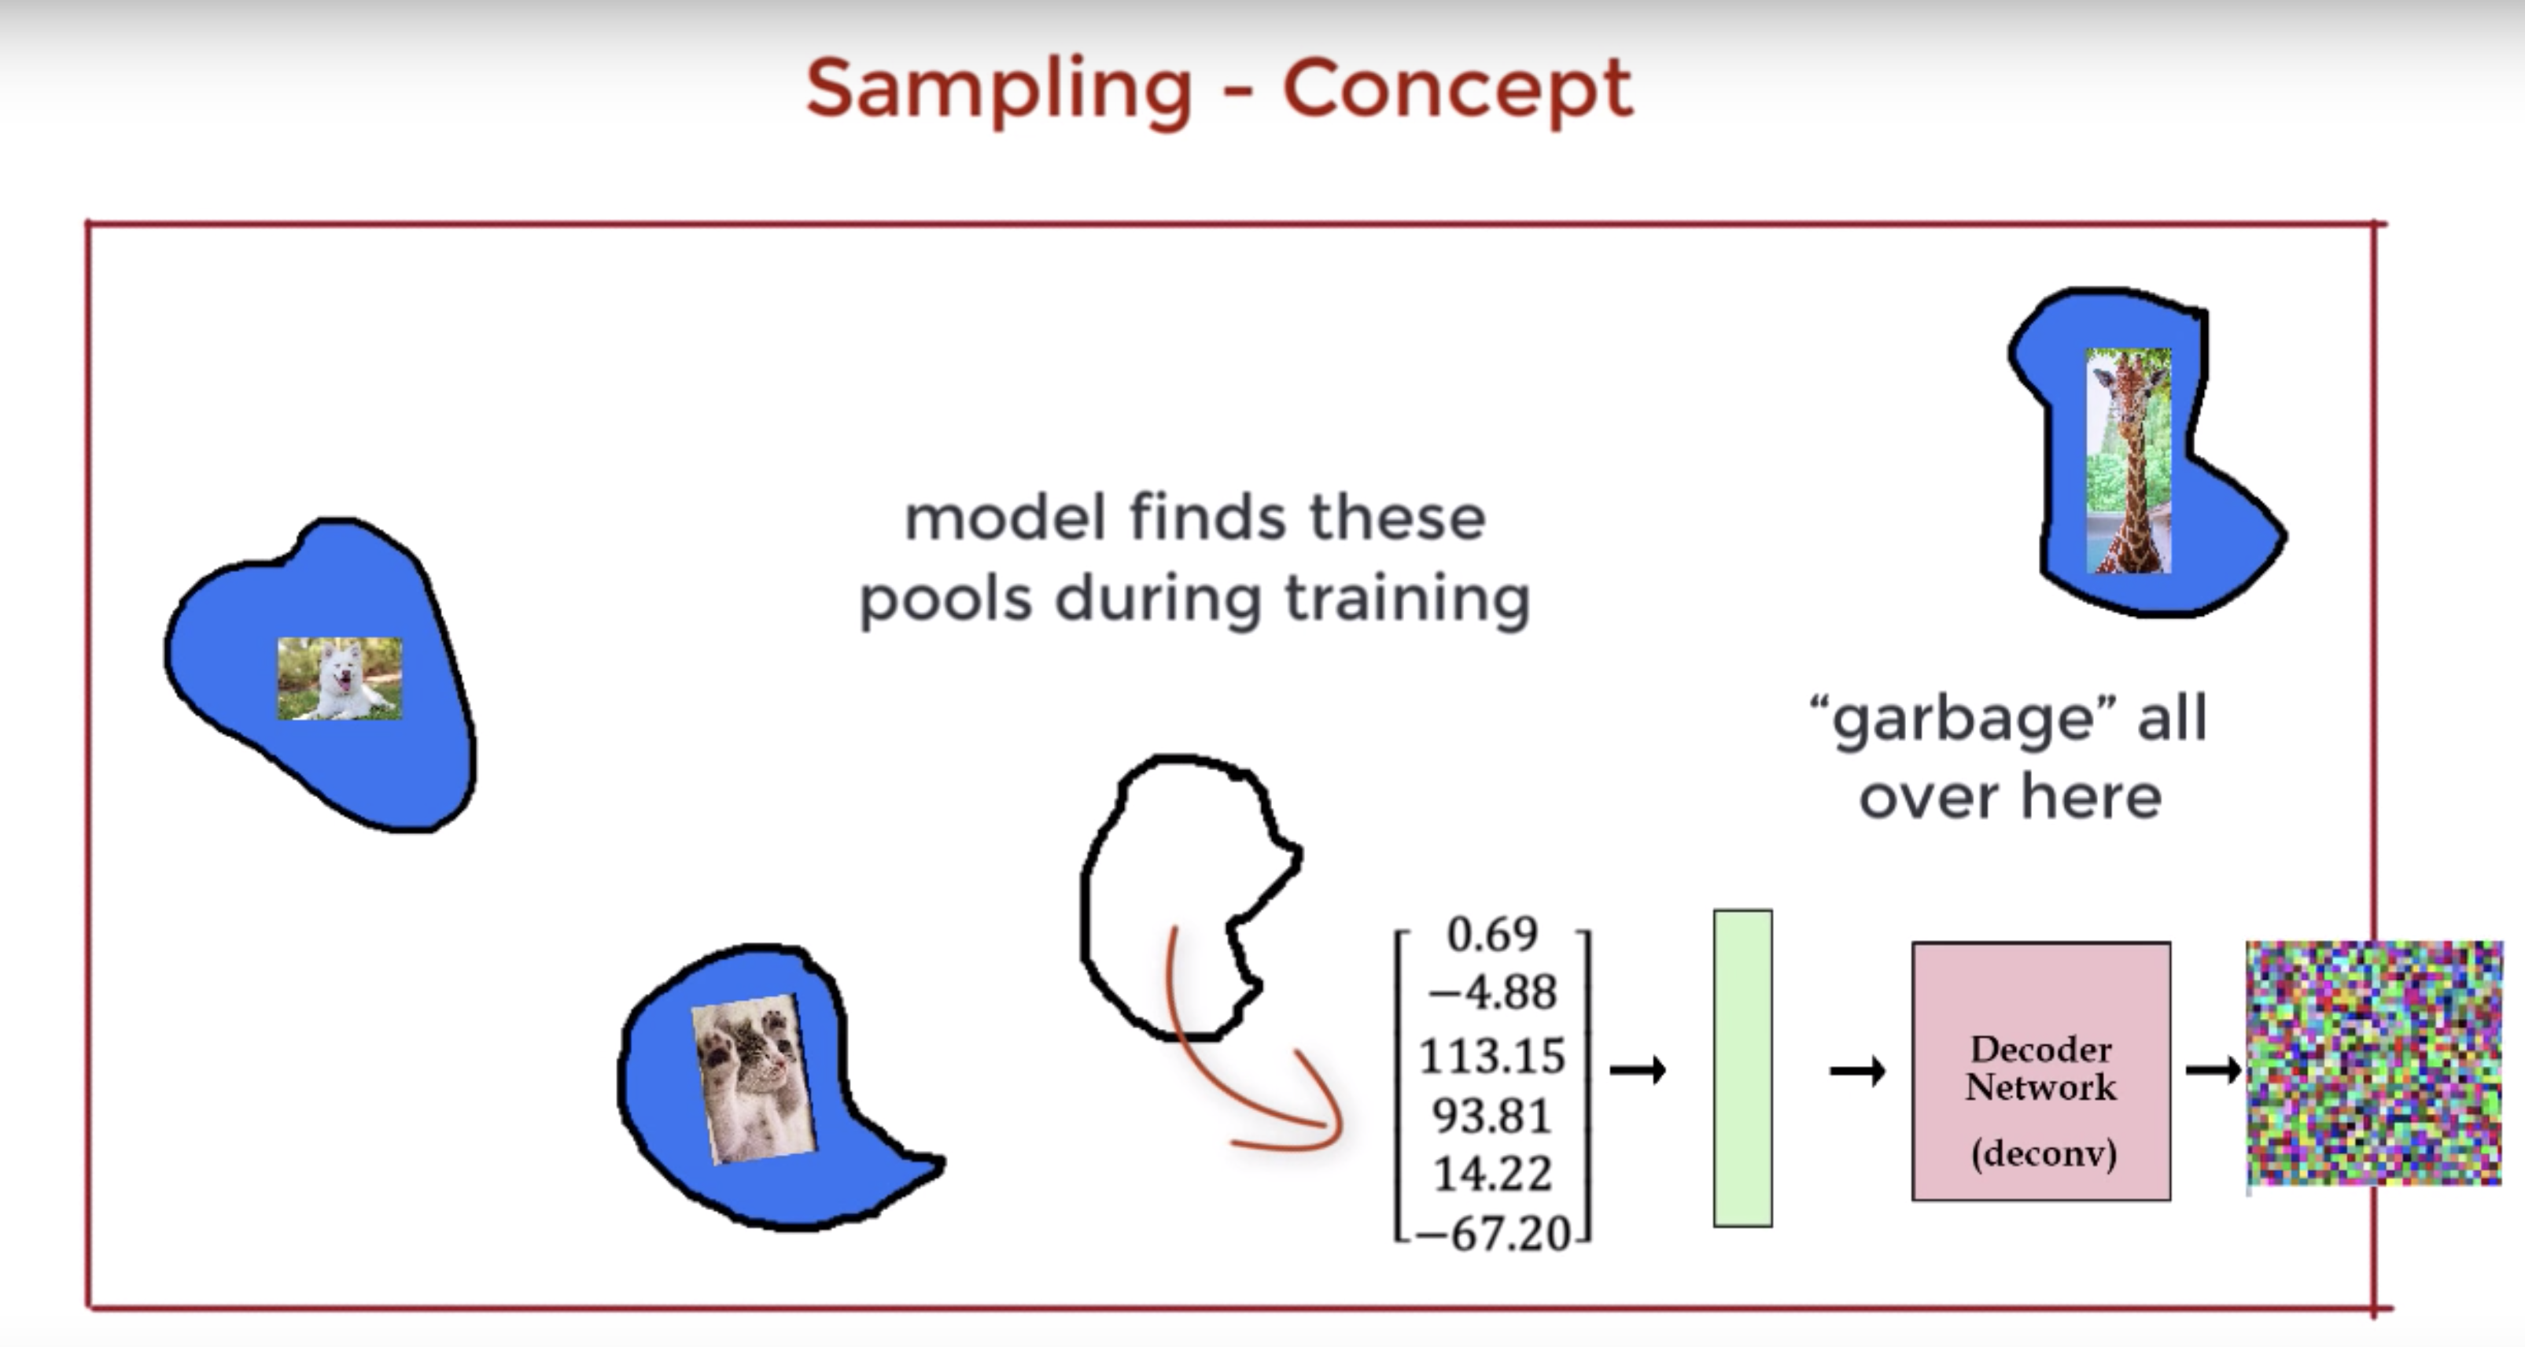

Slide 7
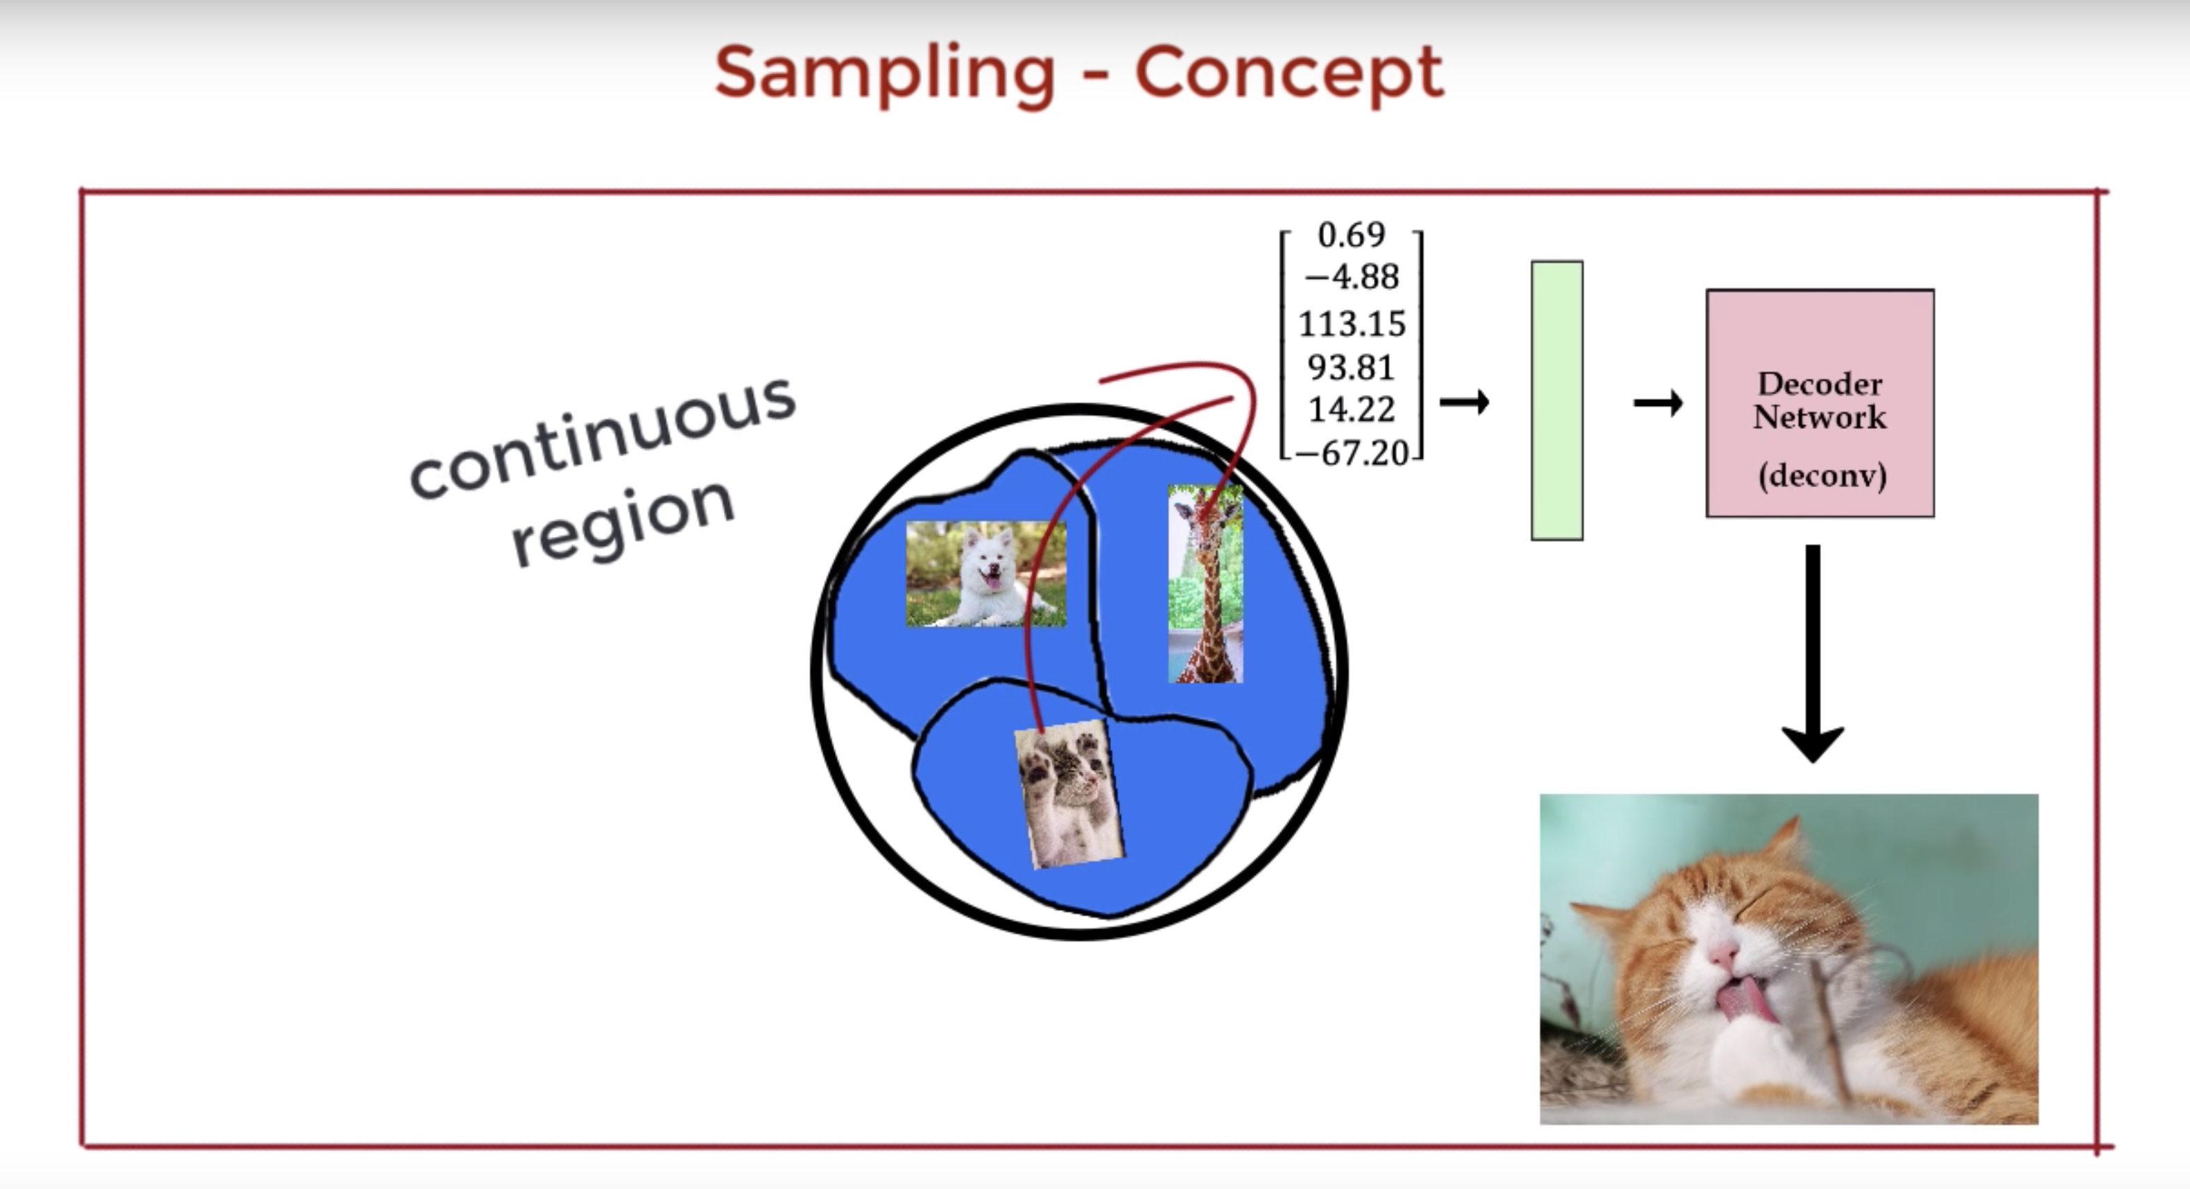
2. How can we make sure that if we sample from our latent space, we are going to get new and meaningful output ?
VAEs achieve this by constricting the latent space.
The encoder and decoder parameters are tuned to accommodate for this setup

Slide 8
But,

Slide 9
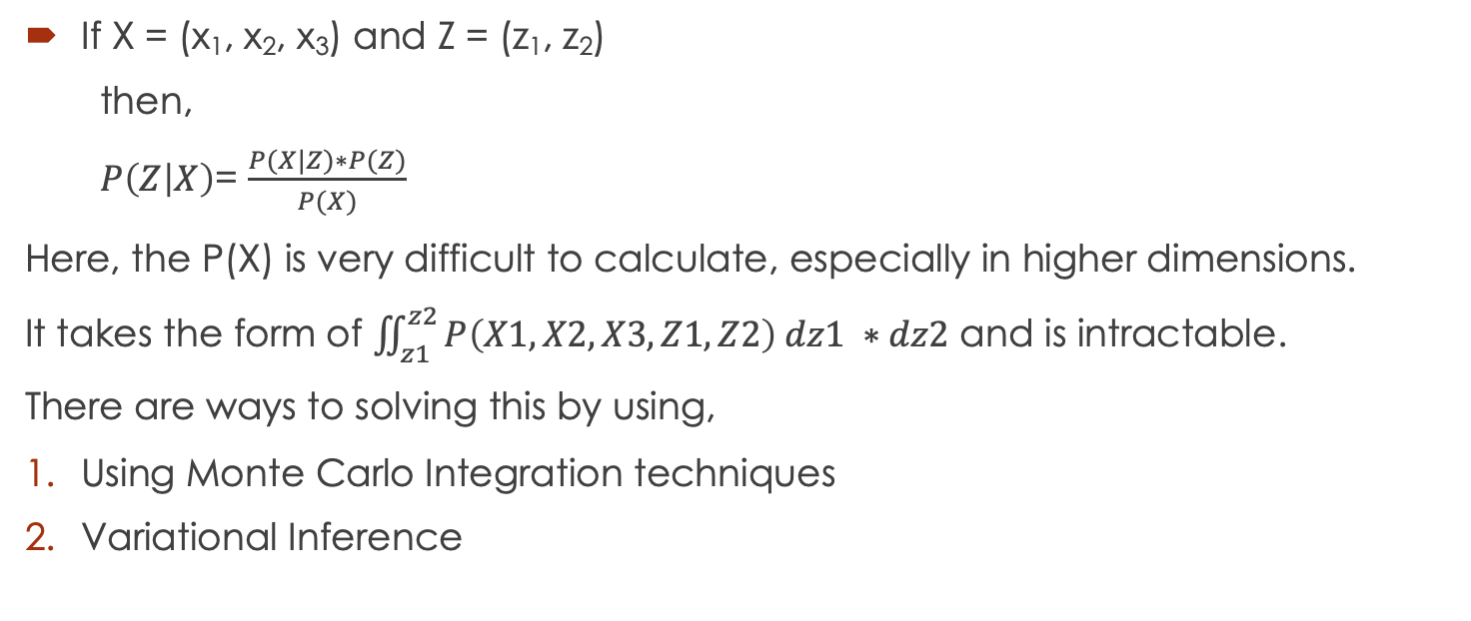
Calculating Marginal Probability
If X = (x₁, x₂, x₃) and Z = (z₁, z₂)
then,
$P\left(Z | X\right)$= $\frac{P(X|Z)∗P(Z)}{P(X)}$
Here, the P(X) is very difficult to calculate, especially in higher dimensions.
It takes the form of $\iint_{z1}^{z2}{P\left(X1, X2, X3, Z1, Z2\right) dz1 ∗dz2}$ and is intractable.
There are ways to solving this by using,
Using Monte Carlo Integration techniques
Variational Inference

Slide 10
Variational Inference

Slide 11
As x is already given, log p(x) is a constant.
And KL(q(z) || p(z|x)) is what we wanted to minimize and it is always >= 0
0 <= p(x) <= 1 and KL >= 0
So, it is equivalent to maximizing the 3rd term.
It is called Variational Lower bound

Slide 12
This is nothing but,
Expectation of p(x|z) w.r.t q(z|x) +
KL(q(z) || p(z|x))
So, Maximizing lower bound means,
Minimizing KL (as >=0), and
For a given q and z, maximize the the likelihood of observing the x

Slide 13
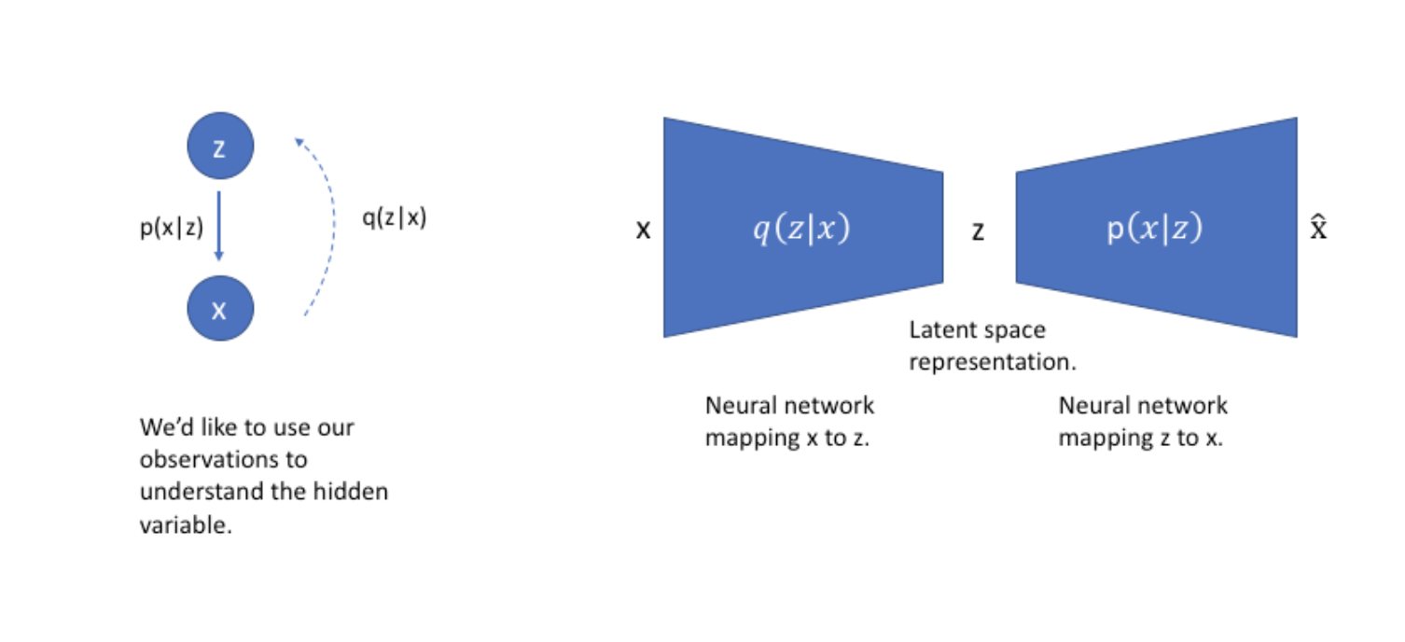

Slide 14
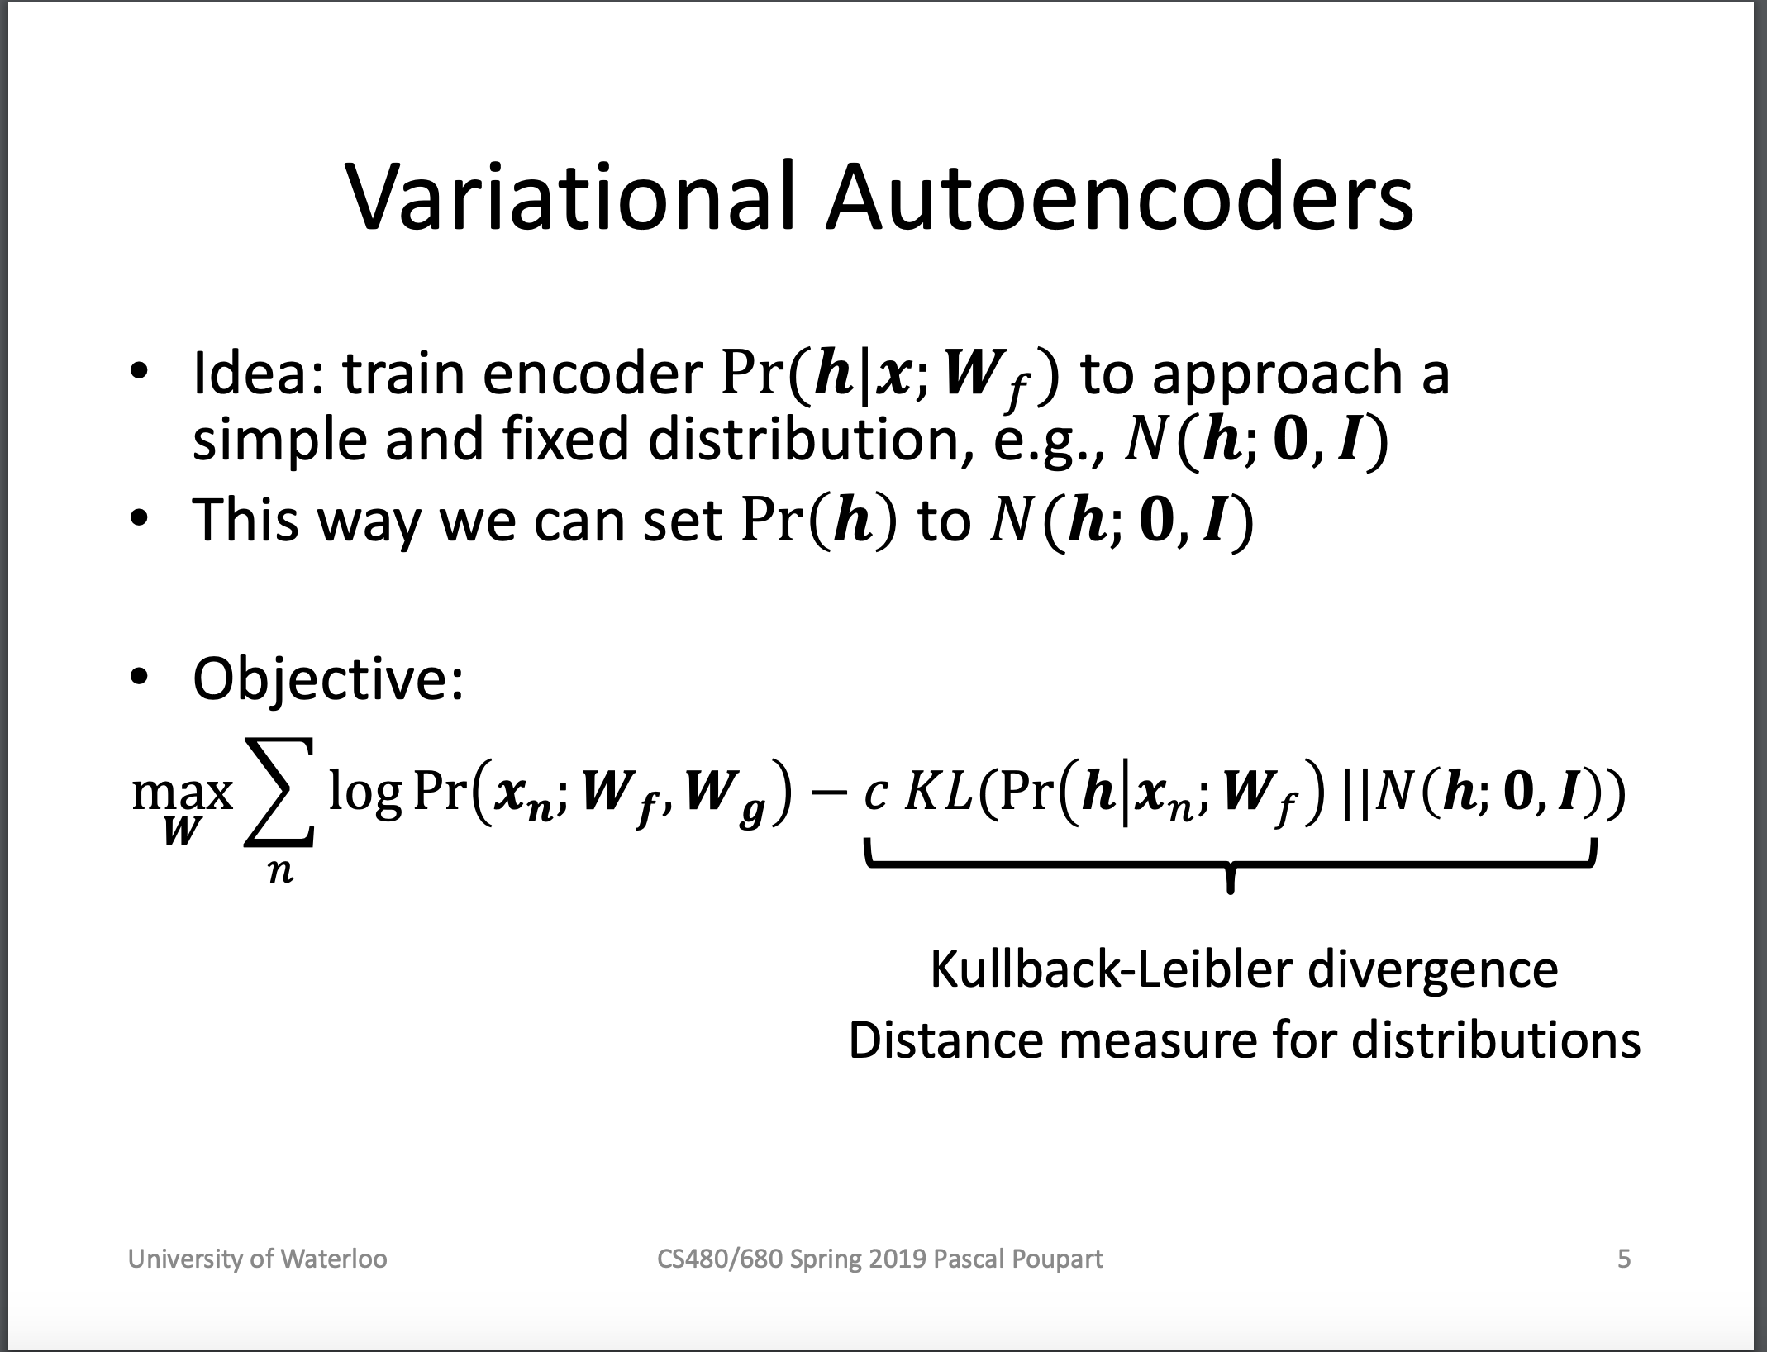

Slide 15
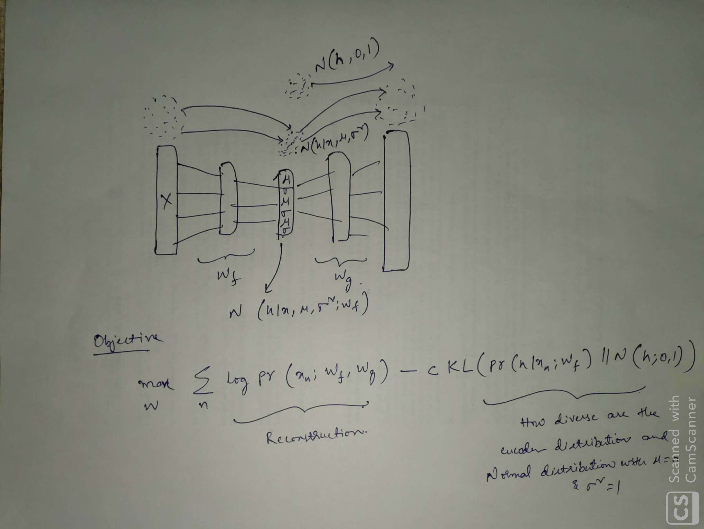

Slide 16
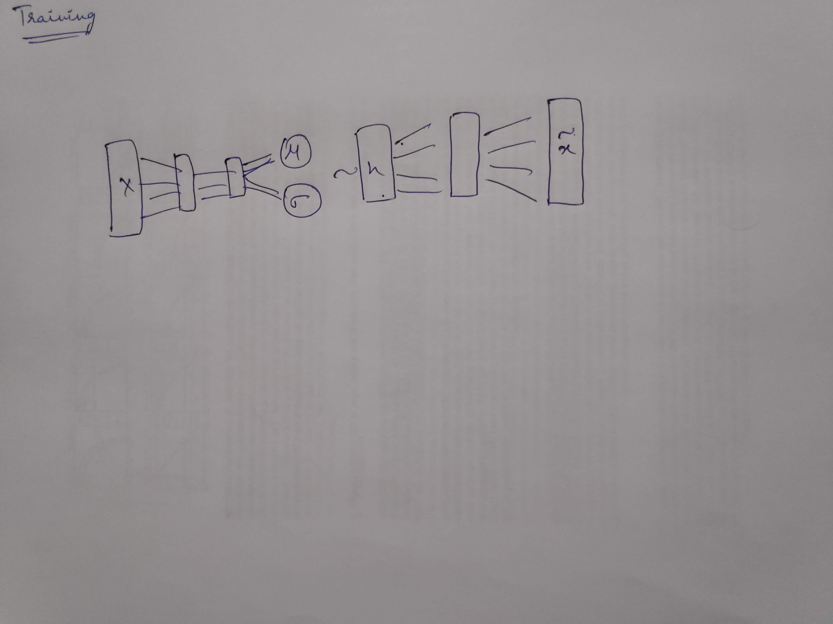

Slide 17
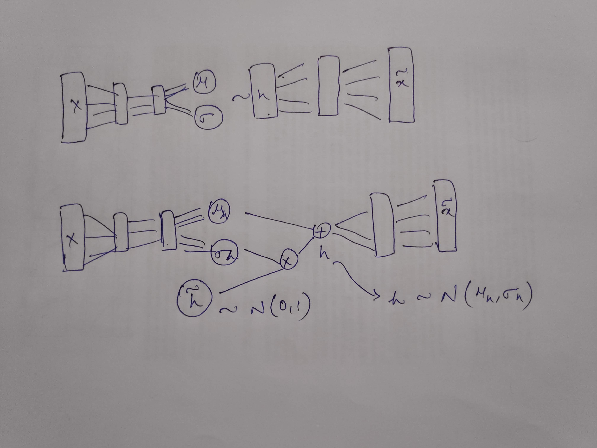
Reparameterization Trick

Slide 18
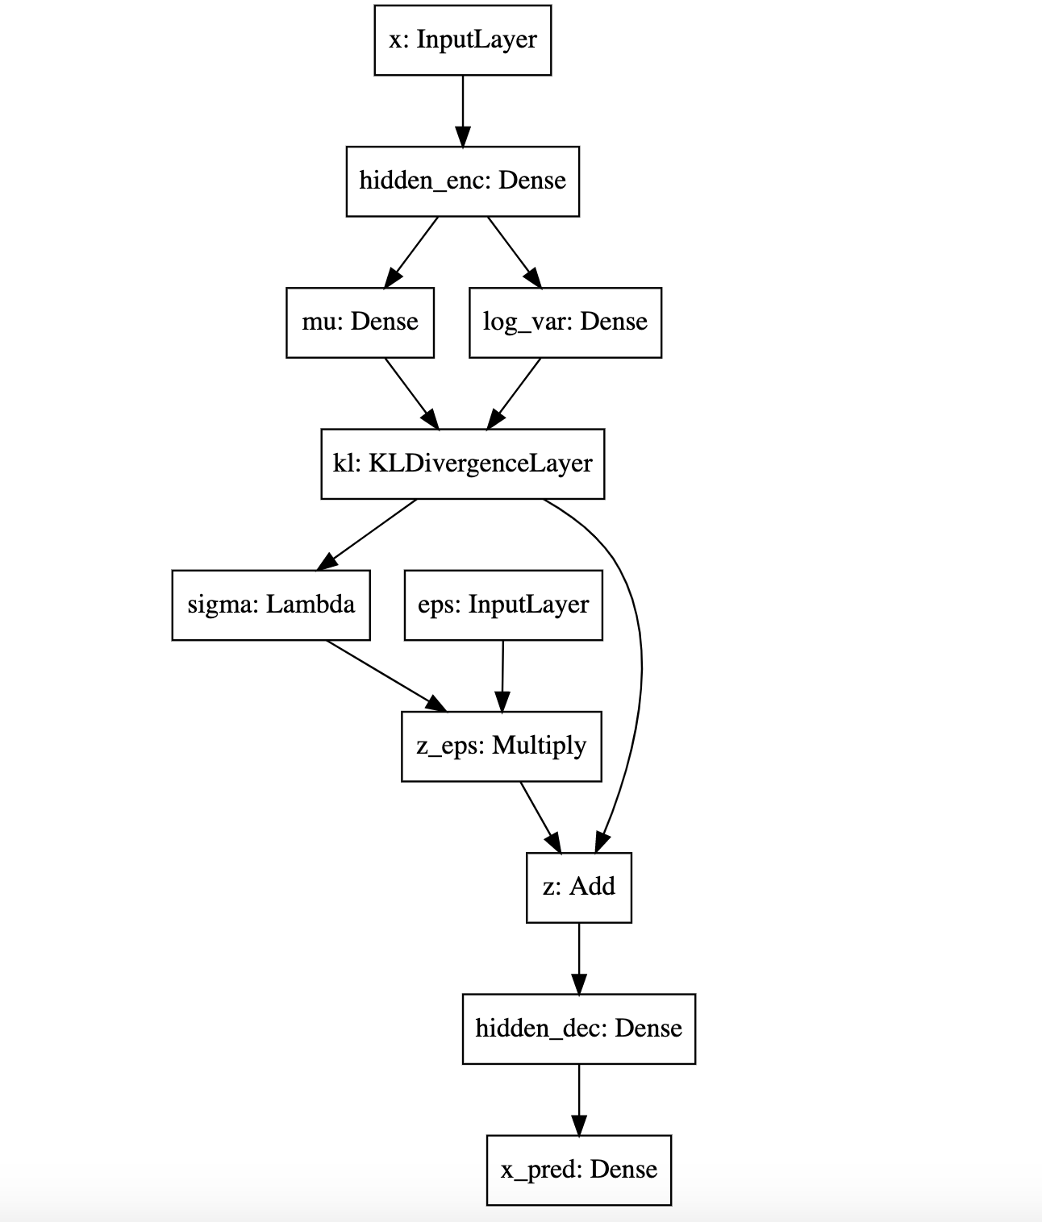
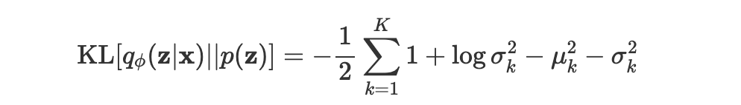
VAE Architecture

Slide 19
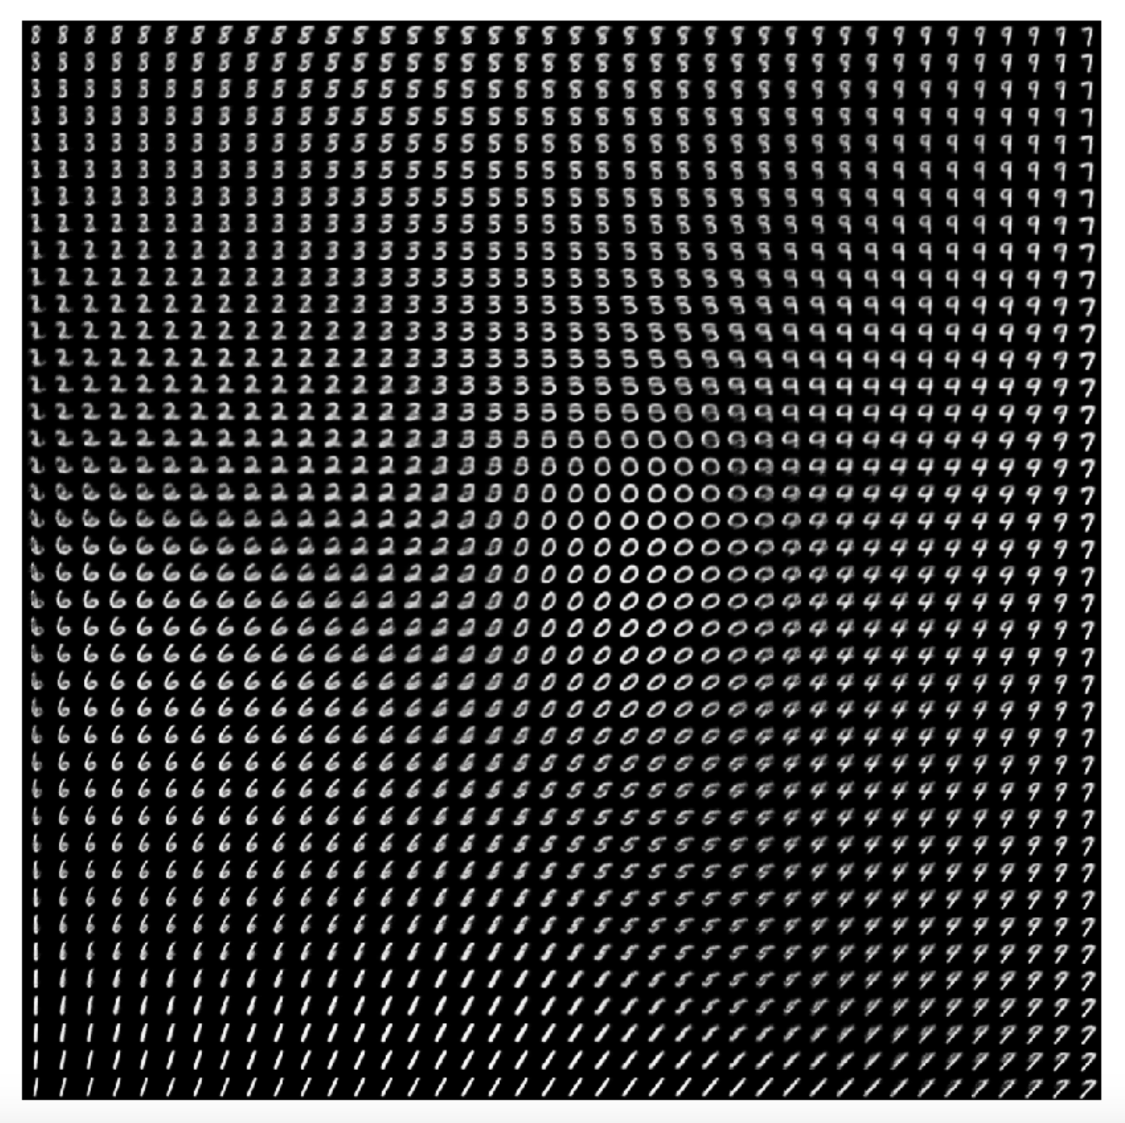

Slide 20
References
Lecture by Ali Ghodsi https://www.youtube.com/watch?v=uaaqyVS9-rM
Lecture by Pascal Poupart https://www.youtube.com/watch?v=DWVlEw0D3gA

Slide 21
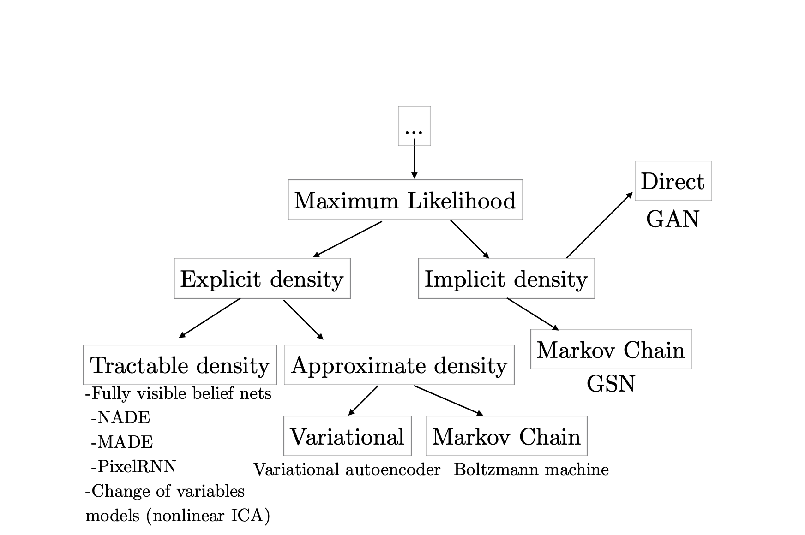
Hierarchy of Generative Models
Figure from Ian Goodfellow’s tutorial on GANs, NIPS 2016

Slide 22
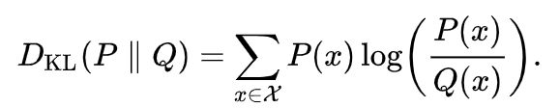
Internals of a VAE’s learning algorithm
KL Divergence

